Slide 1
Figures from the book
Warehouse Science
(Version 0.95)
    ©2011
    John J. BARTHOLDI, III
The Supply Chain & Logistics Institute
Georgia Tech
www.warehouse-science.com

Slide 2
Greetings!
These are many of the figures from the book Warehouse & Distribution Science, freely available from www.warehouse-science.com. They are the ones from which I find it easiest to talk. I hope they are of help in illustrating your lectures.
I ask only that you cite the book where appropriate, such as in any publication that uses these figures.

Slide 3
Introduction

Slide 4
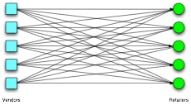

Slide 5
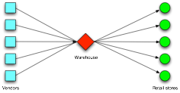

Slide 6
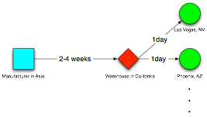

Slide 7
Material Flow

Slide 8


Slide 9
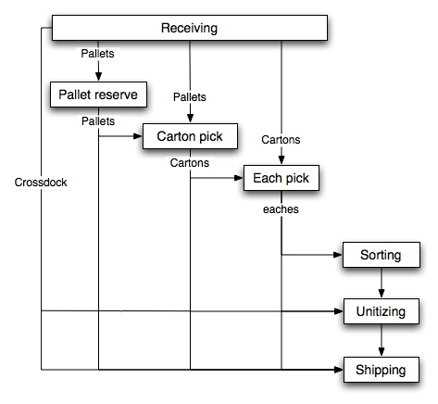

Slide 10
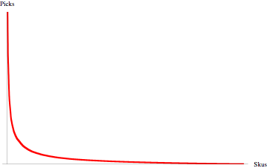

Slide 11
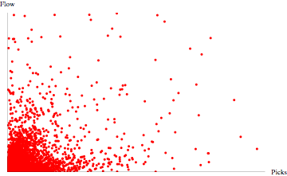

Slide 12
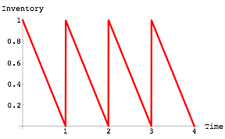

Slide 13
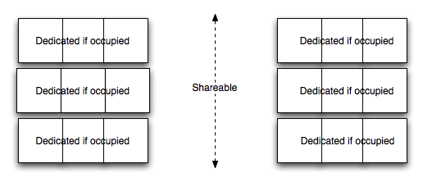

Slide 14
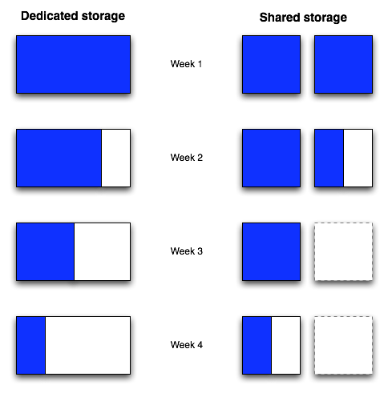

Slide 15
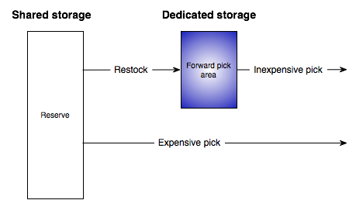

Slide 16
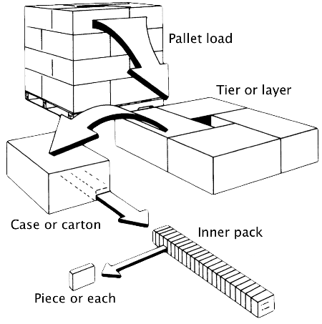

Slide 17
Pallets (unit-load)

Slide 18



Slide 19


Slide 20


Slide 21
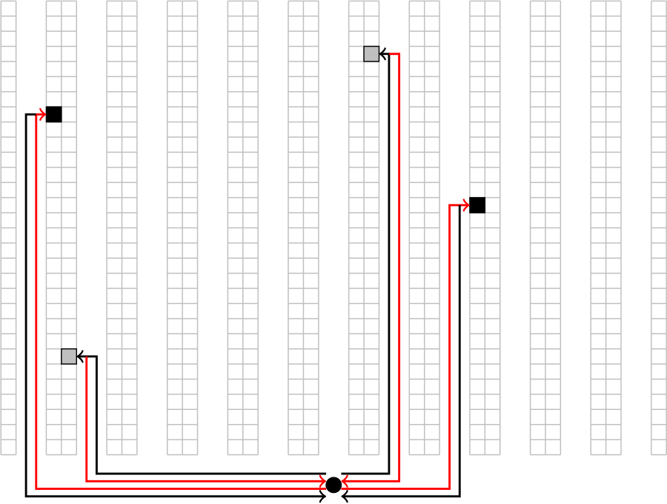

Slide 22
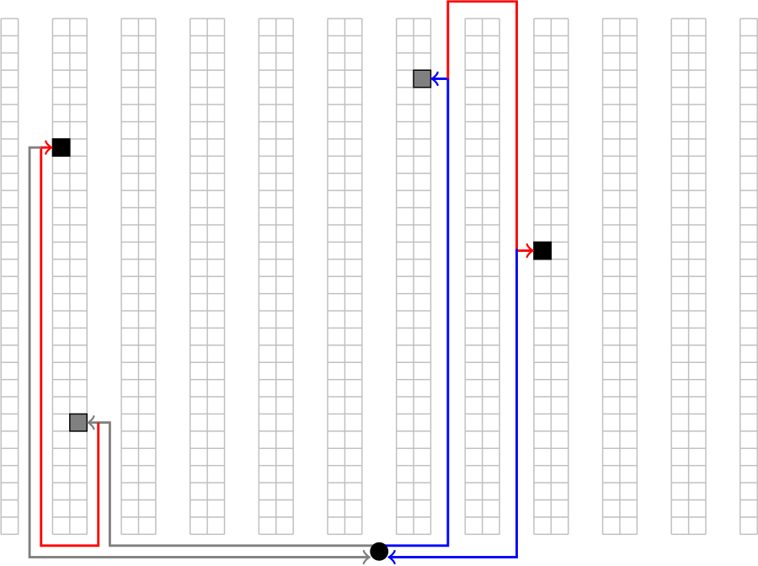

Slide 23
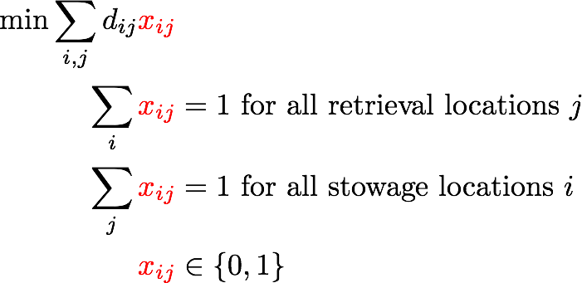

Slide 25
Add figures about assignment problem

Slide 27
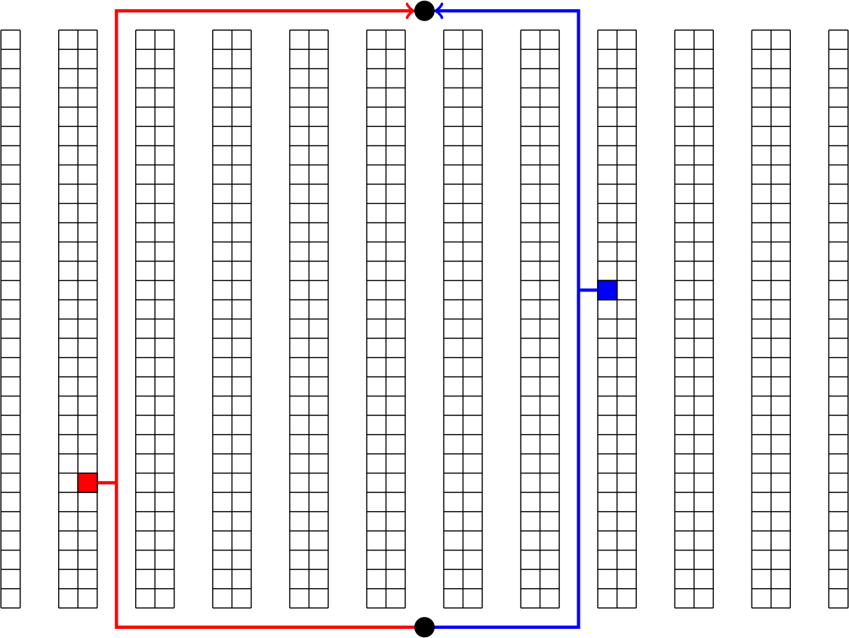

Slide 28


Slide 29
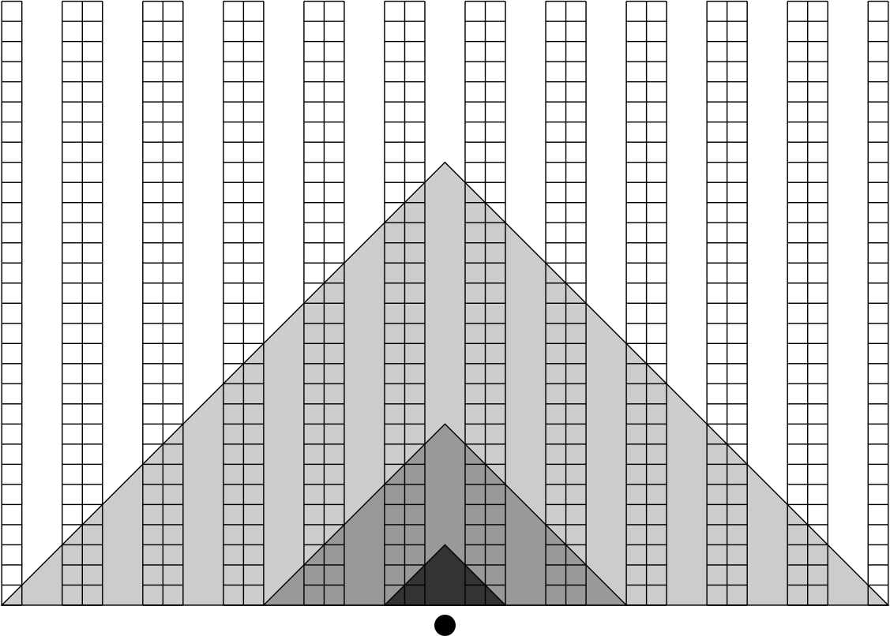

Slide 30
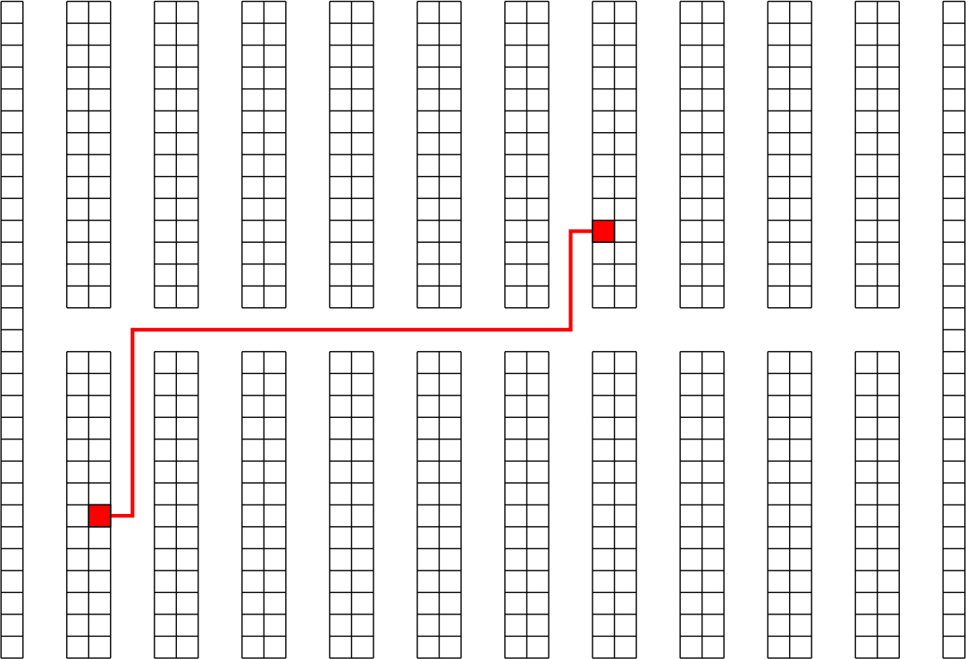

Slide 31
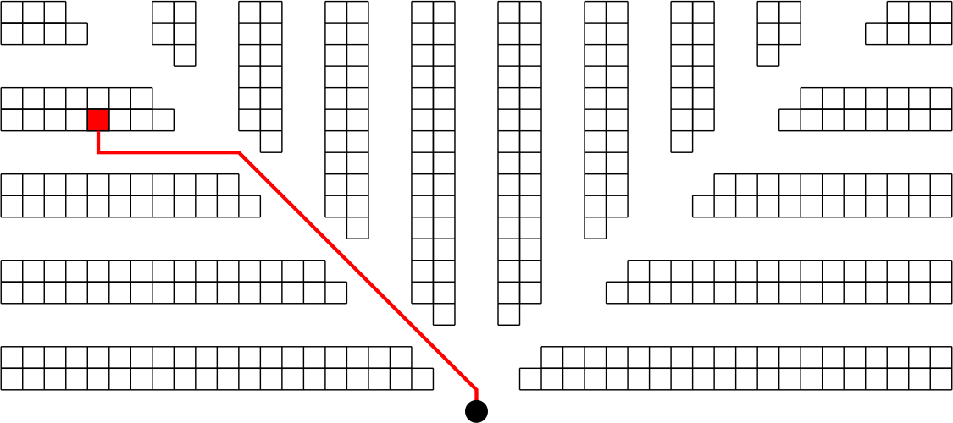

Slide 32


Slide 33


Slide 34
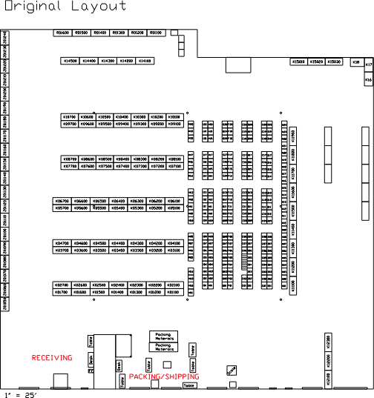

Slide 35
Cartons

Slide 36
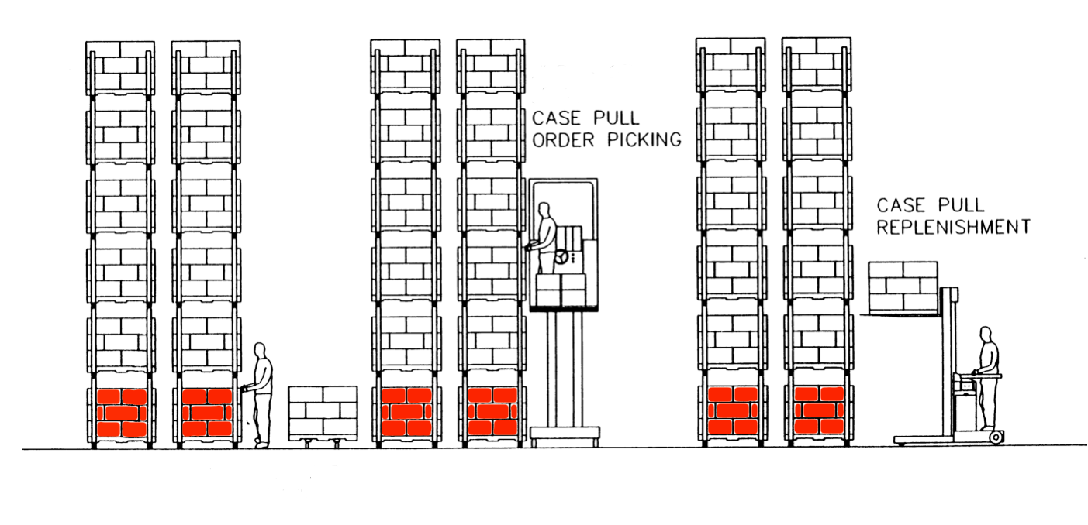

Slide 37
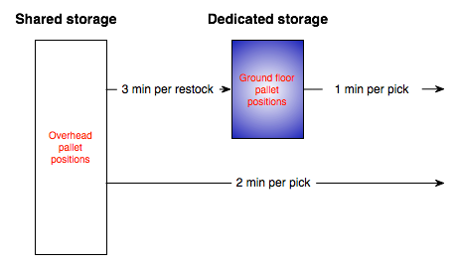

Slide 38
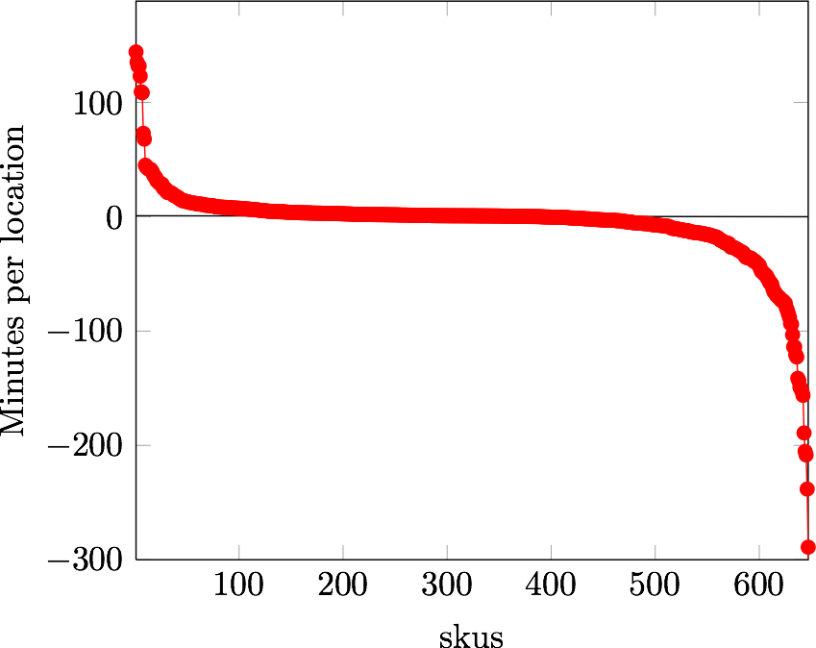

Slide 39



Slide 40
Pieces

Slide 41
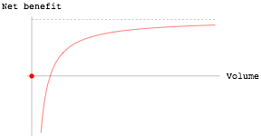

Slide 42
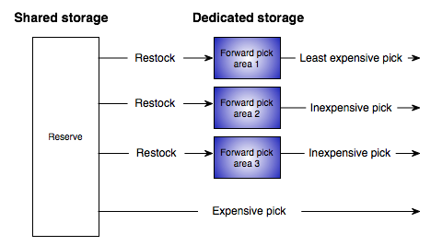

Slide 43
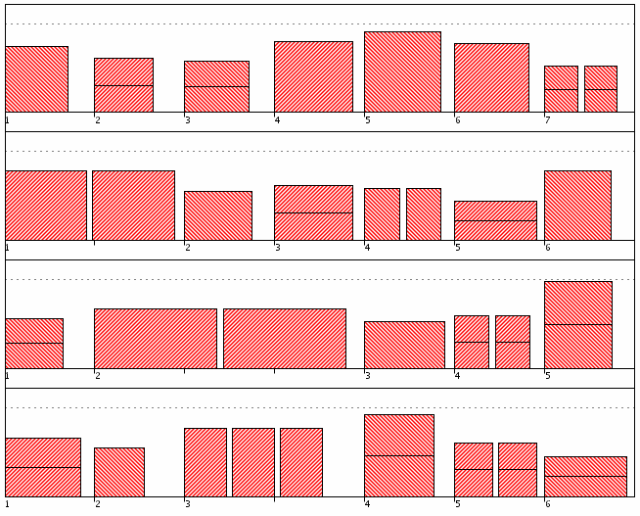

Slide 44
Detailed slotting

Slide 45
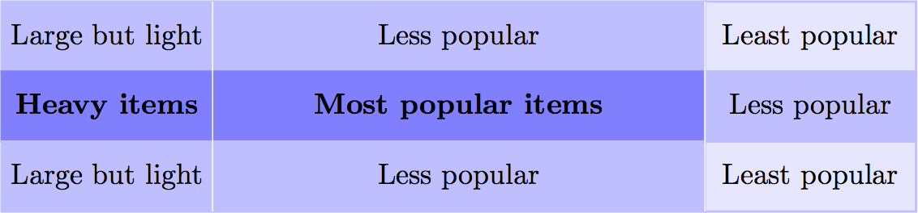

Slide 46
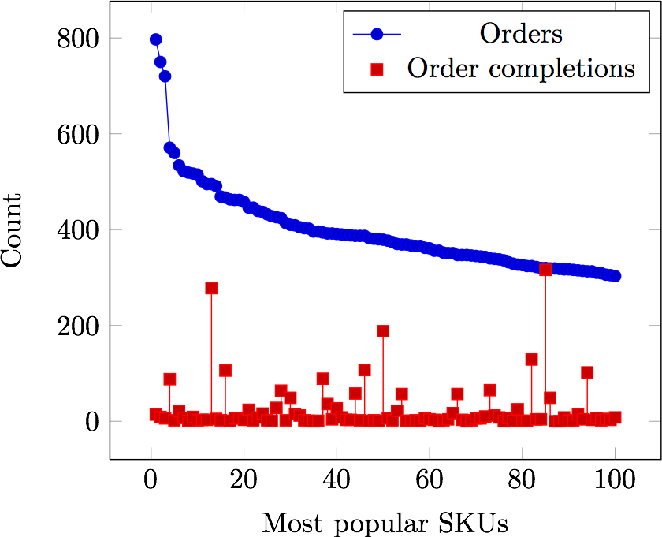

Slide 47
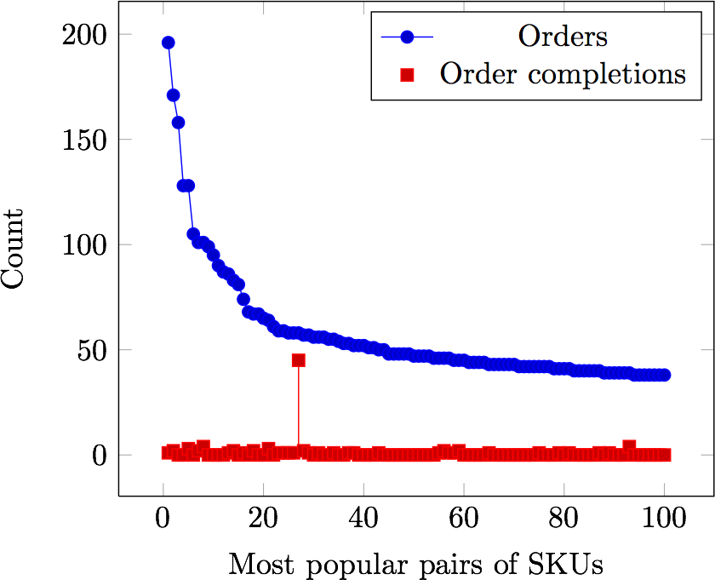

Slide 48
Pick-paths

Slide 49
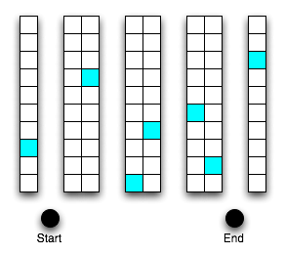

Slide 50


Slide 51


Slide 52
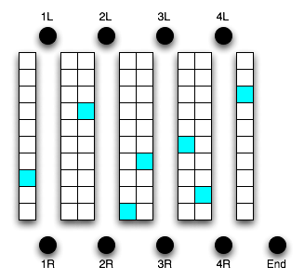

Slide 53
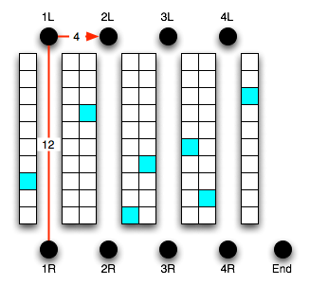
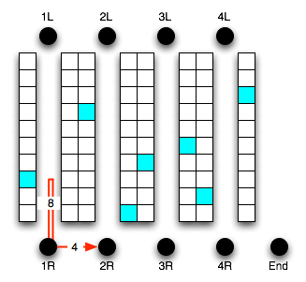
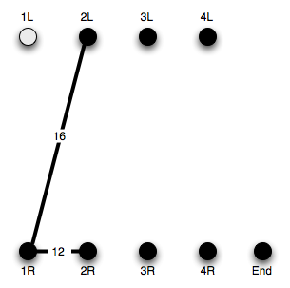

Slide 54
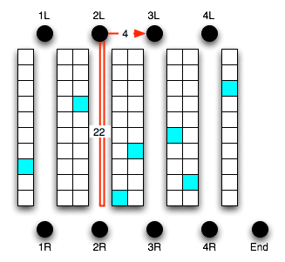
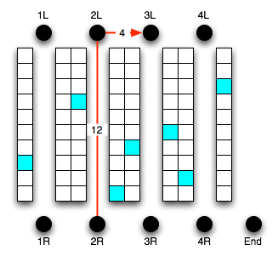
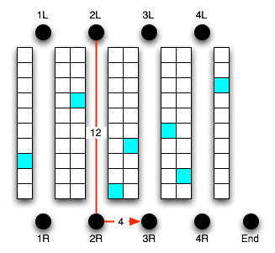
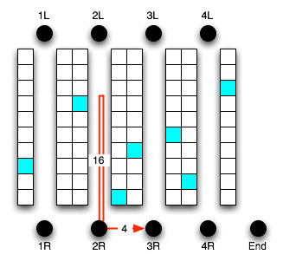

Slide 55
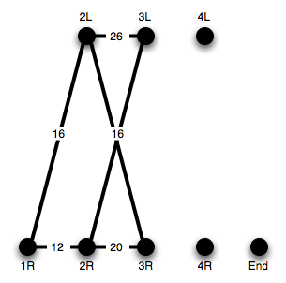

Slide 56
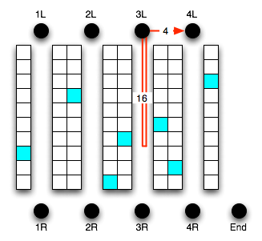
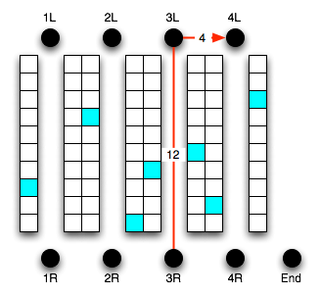
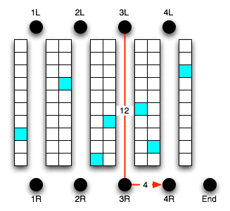
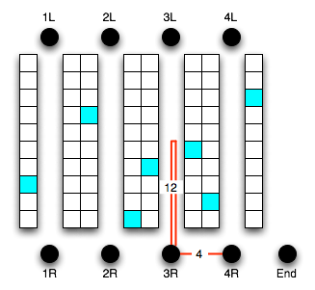

Slide 57
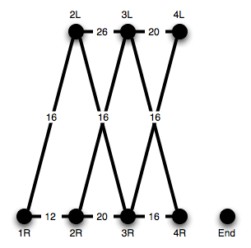

Slide 58
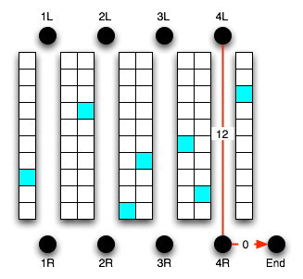
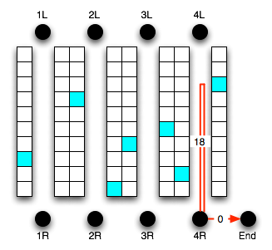
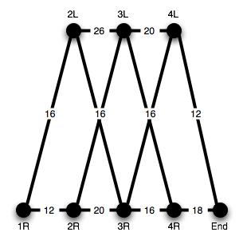

Slide 59
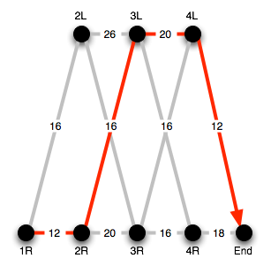
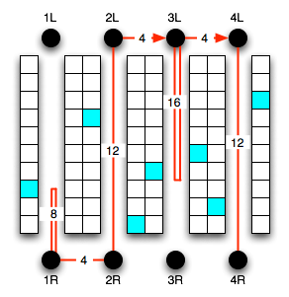

Slide 60
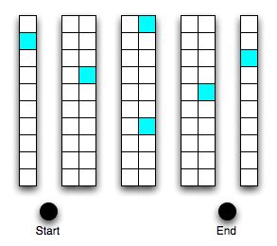
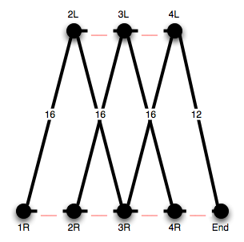

Slide 61


Slide 62


Slide 63


Slide 64
Bucket Brigades

Slide 65


Slide 66



Slide 67


Slide 68


Slide 69


Slide 70


Slide 71
Automation

Slide 72


Slide 73


Slide 74


Slide 75


Slide 76


Slide 77


Slide 78


Slide 79


Slide 80
Activity Profiling

Slide 81


Slide 82


Slide 83


Slide 84
Benchmarking

Slide 85


Slide 86


Slide 87


